Slide 1
Keeping Milk Cold

Slide 2
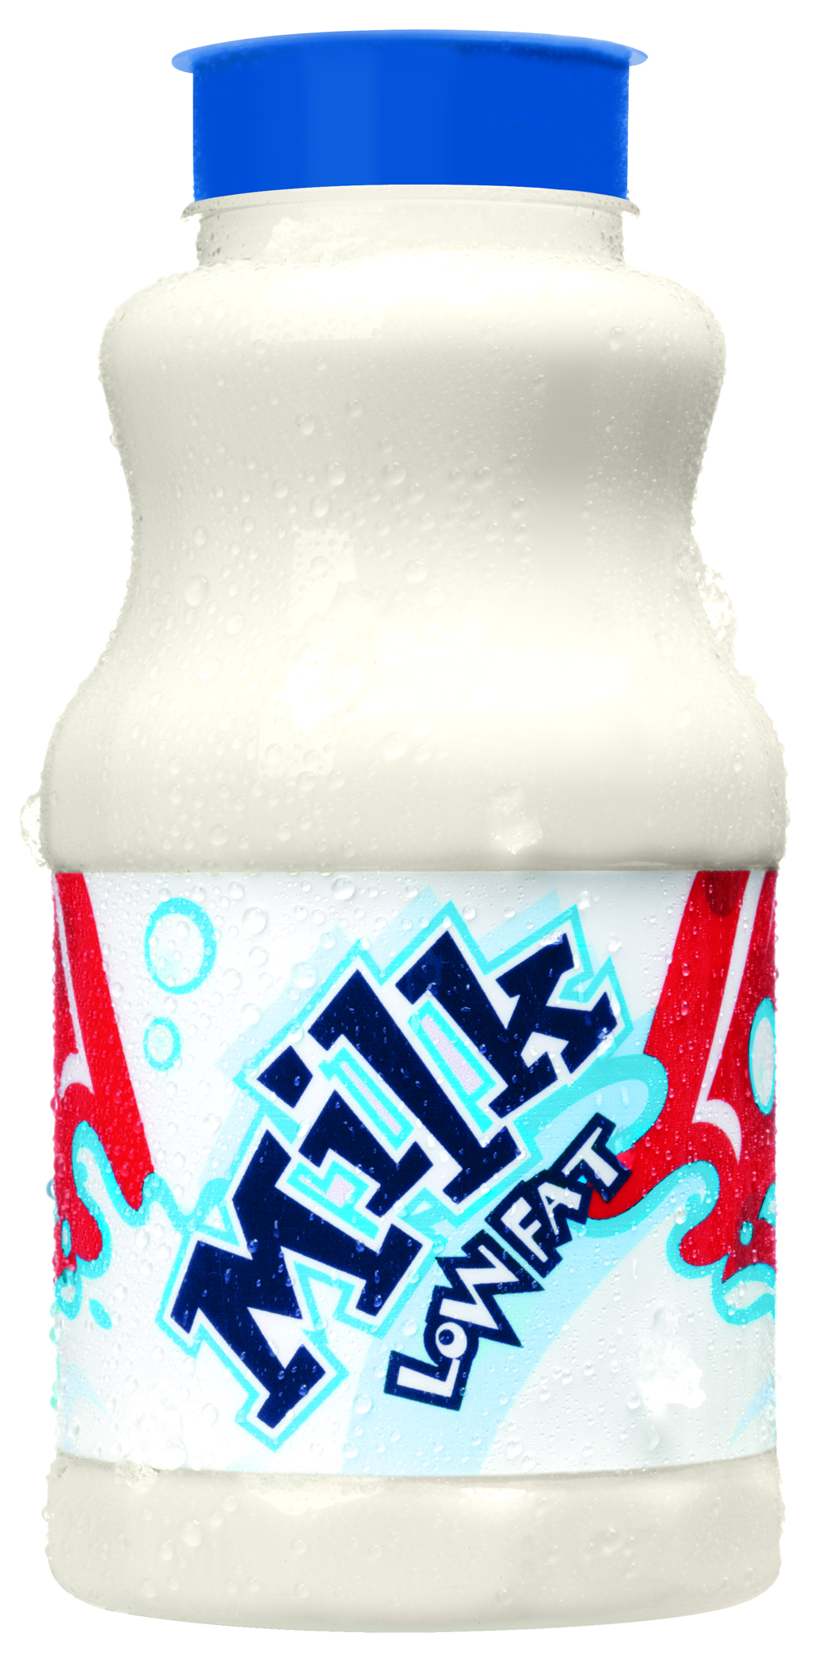
Agenda
Thermometer Calibration
Milk from Dairy Farm to School
Keeping Milk Cold at School

Slide 3
Calibration 101
What is Thermometer Calibration?
Adjusting the thermometer so that it reads the correct temperature by using known temperatures of either freezing or boiling
When to Calibrate?
Daily
When dropped
After exposure to extreme temperature changes

Slide 4
Calibration 101
Why Calibrate?
A thermometer that is not properly calibrated measures the incorrect temperature
An incorrect food temperature can lead to possible occurrence of food borne illness
Hot food tastes best hot, and cold food tastes best cold

Slide 5
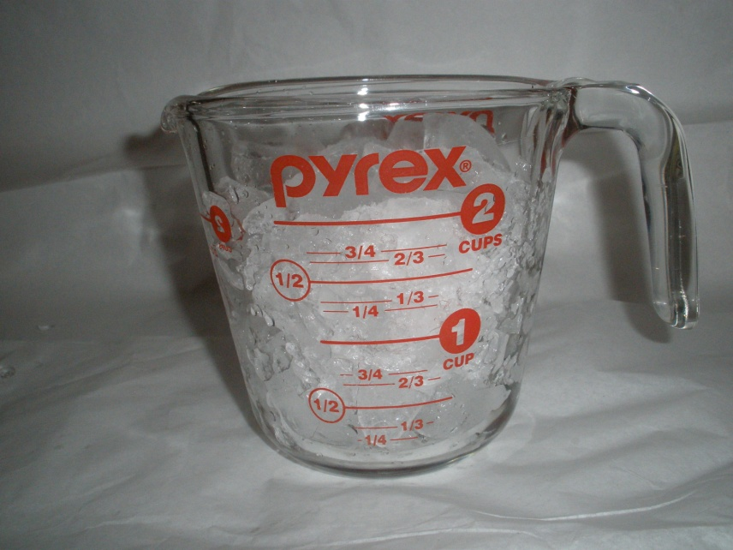
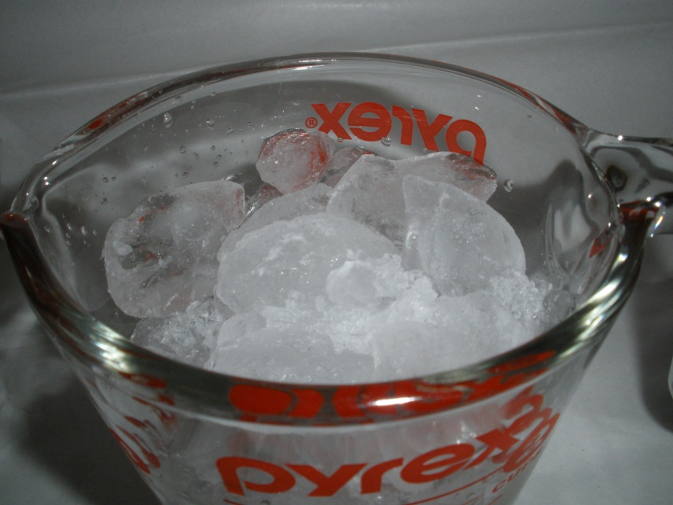
Ice Bath Calibration
1. Fill a container with ice (crushed is best)
Notes:
Have assistant demonstrate steps while you discuss. Have employees perform steps at their stations during demonstration.

Slide 6
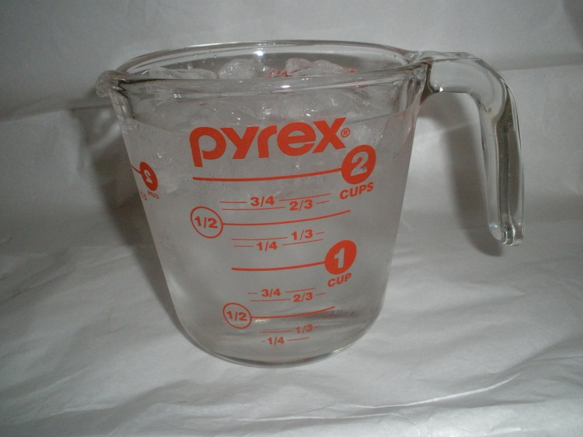
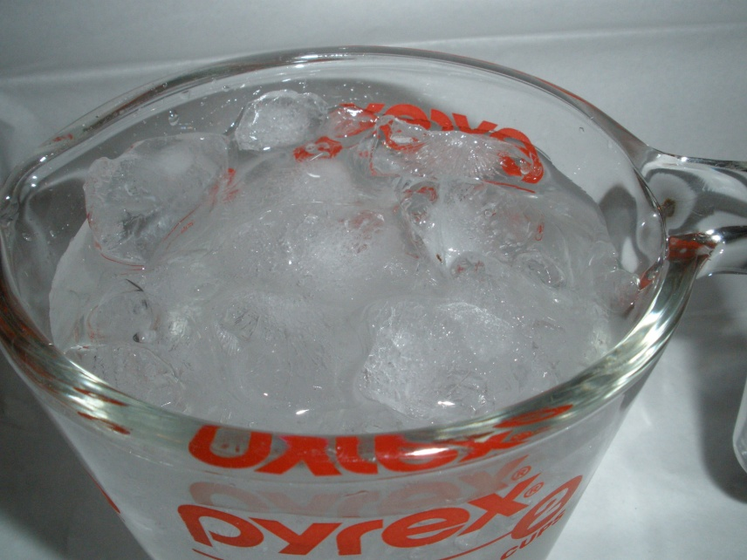
Ice Bath Calibration
2. Add cold water, mix and let sit for one minute

Slide 7
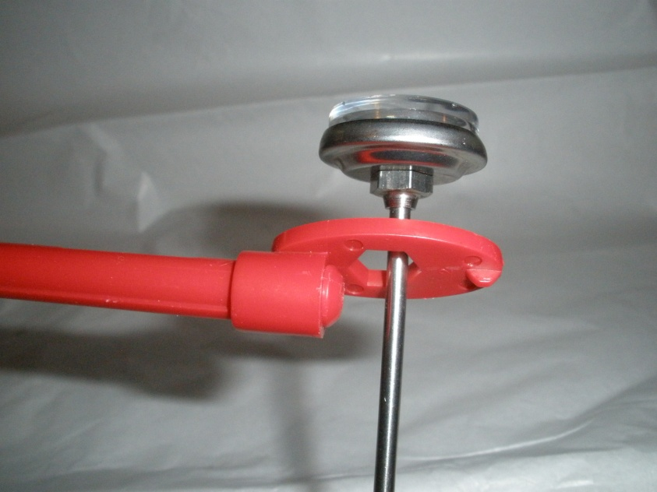
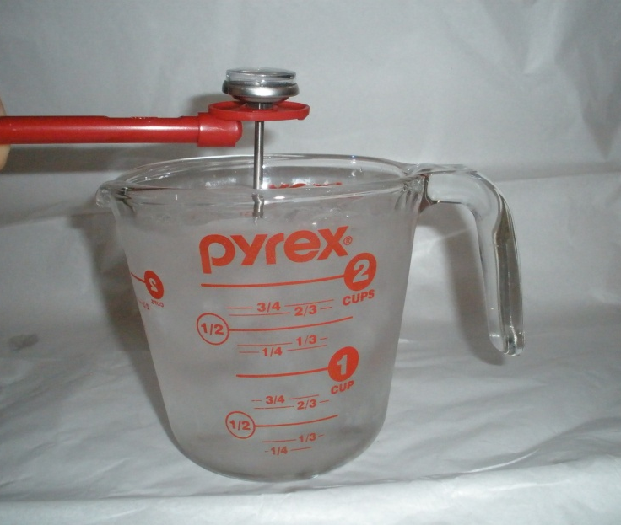
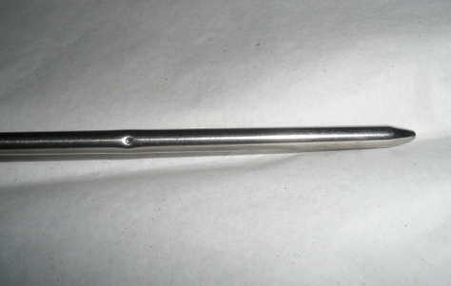
Ice Bath Calibration
3. Insert thermometer so the sensing area is covered
Notes:
IMPORTANT:
Insert thermometer into wrench on cover prior to placing it in ice bath (if applicable)
Insert up to the dimple
Ensure thermometer does not touch sides of container

Slide 8
Ice Bath Calibration
4. Wait for 30 seconds or until needle on dial stops moving
5. Rotate hex nut below dial until thermometer reads 32° F
Do not remove from ice bath while adjusting
If your thermometer has a reset button instead of an adjusting nut, push reset

Slide 9
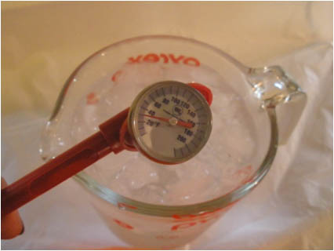
Ice Bath Calibration
6. Let thermometer sit for additional 30 seconds to verify 32° F

Slide 10
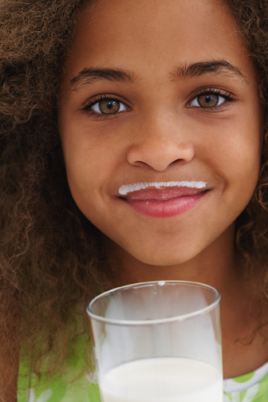
Kids Love Cold Milk!
Kids will drink more milk when:
It’s served at 35° F
Milk served above 40° F doesn’t taste as good
Attractively displayed
Provided with milk choices
Served in kid-friendly plastic packaging
Milk Temp Check Time!
Notes:
Have employees check the temperature of a milk with their newly calibrated thermometer. Then record the time, temp and rate the taste of the milk on the Milk Quality Check List.
Once they are finished the milk should remain on the table for the remainder of the in-service. The taste and temp will be checked 2 more times to show how temperature abuse can impact the flavor of milk.

Slide 11
Milk from Dairy Farm to You
Notes:
Now we will talk about New England Dairy Farms and how this milk [point at milk container] got from the cow to you [point at person with milk container].

Slide 12
Let’s Follow Milk on its Journey
Notes:
Did you know that the milk your school serves is produced by dairy farmers in and around the New England area? During a time when many people are trying to eat local foods, milk is often overlooked. Be proud that you’re serving students a wholesome local product!
Show hard copy of poster if available. – Posters can be purchased through our catalog at www.NewEnglandDairyCouncil.org.

Slide 13
Farm Families
New England has 1,700 dairy farms
Farms operate 24 hours a day, 7 days a week, 365 days a year
Family farms employ generations
Notes:
It all starts with farmers. New England is home to more than 1,700 dairy farms and the families who live there. Most farms are passed along from generation to generation. Kids learn from their parents and grandparents about caring for the animals, planting and harvesting crops and producing wholesome milk.

Slide 14
Barn Sweet Home
Cows are all female
Cows are pregnant for nine months
Cows are big eaters!
40 pounds of feed and hay
50 pounds of silage (fermented corn)
Notes:
All cows are female. Like humans, they cannot produce milk until they give birth. Cows usually have their first calf when they are 2 years old. Cows are pregnant 9 months, just like humans! Cows are usually milked for 305 days (10 months) after giving birth. Then they are allowed to “dry off” for about 2 months until their next calf is born.
Cows are big eaters. Each day they eat approximately 40 pounds of feed and hay, 50 pounds of silage (special fermented corn).
Today, most cows live in free-stall barns. That means cows get to freely walk around, eat between milkings and enjoy resting up to 14 hours a day.

Slide 15
Milking Parlor
Cows are milked two or three times a day
It takes five minutes to milk a cow
Cows produce an average 25 pounds (45 cups) of milk in one milking
Notes:
The milking parlor is the place where the cows are milked. A milking machine, attached to the cow’s udder, gently removes the milk in about 5 minutes. Cows are milked two to three times a day. The cow’s udder can hold up to 25-50 pounds of milk.

Slide 16
Inspection
Not only is every dairy farm inspected, but all milk is sampled before it leaves the farm
Clean equipment and sanitation are important
Milk is never touched by human hands
Notes:
Farmers pay close attention to everything that happens on the farm and keep records on every cow, like how much they eat and how much milk they produce. Dairy farmers are very dedicated to producing wholesome, nutritious milk. Every dairy farm is inspected and milk samples are taken and tested before milk can leave the farm.

Slide 17
The Milk Truck (a.k.a Tanker Truck)
Milk is cooled quickly in the cooling tank
Leaves the cow at 101° F
Cooled to below 45° F in just minutes
Milk trucks come every day or two to pick up the milk
Notes:
After the milk leaves the cow it is 101° F. It is quickly cooled in a refrigerated storage tank to below 45° F or lower to keep it fresh and good tasting. It is stored here until the milk truck comes. The milk truck comes every day or two to pick up milk. Milk is pumped into the insulated truck so it is kept fresh and cold on its way to the dairy processing plant.

Slide 18
Bottling Machine
All milk is tested before it is off-loaded from the milk truck
Milk is homogenized and pasteurized
Notes:
At the milk plant, milk is tested again to ensure only the purest milk is used. It is then homogenized to break the butterfat particles into tiny, uniform globules. If milk wasn’t homogenized, the cream would rise to the top. You would have to shake or stir the milk before serving.
The milk is also pasteurized. Pasteurization is a heat process that eliminates unwanted bacteria but retains the nutrients.

Slide 19
Milk Delivery
Milk is on its way to you in about two days from the time it leaves the cow
Keep milk fresh and cold; store at 40° F or lower
Notes:
It takes about 2 days from the time milk leaves the cow until the time it reaches your school. Because milk is perishable, it must be refrigerated at 40° F or colder.

Slide 20
Now It’s Your Turn…
Dairy farmers work hard to deliver fresh, wholesome milk to your school
Now it is up to you to keep it cold and fresh for your students
Notes:
Click on link to bring up From Farm to You: The Story of Milk video on YouTube (you must have internet connection)

Slide 21
VIDEO
Notes:
Click on black box to bring up From Farm to You: The Story of Milk (will take a moment to start)

Slide 22
Keeping Milk Cold in Schools
Delivery
Storage
Service
Milk Temp Check Time!
Notes:
Have employees test temperature and taste of their milk and record on Check List.
The dairy farmers and processors have done a great job getting cold tasty milk to us. Now we will discuss how we can ensure the milk stays as cold as possible, because kids love cold milk.

Slide 23
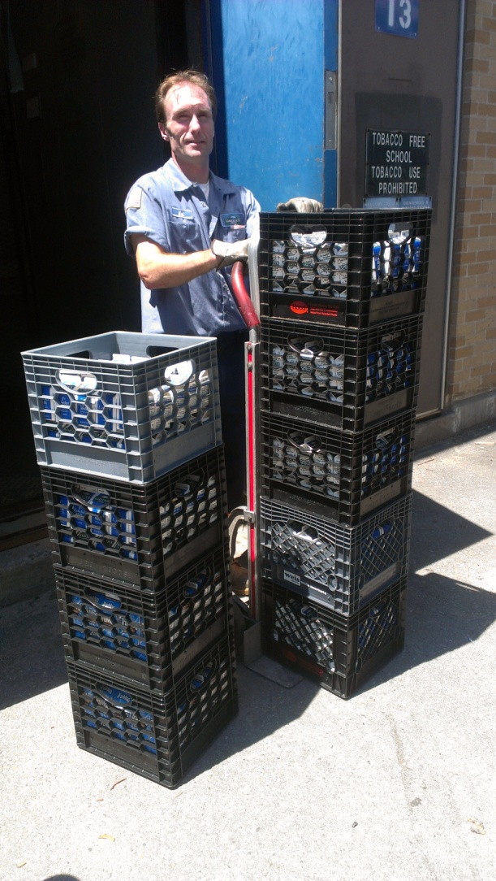
Delivery
Check for dirty or damaged containers
Check sell-by date
Two weeks in advance is preferred
Take milk immediately to storage upon delivery

Slide 24
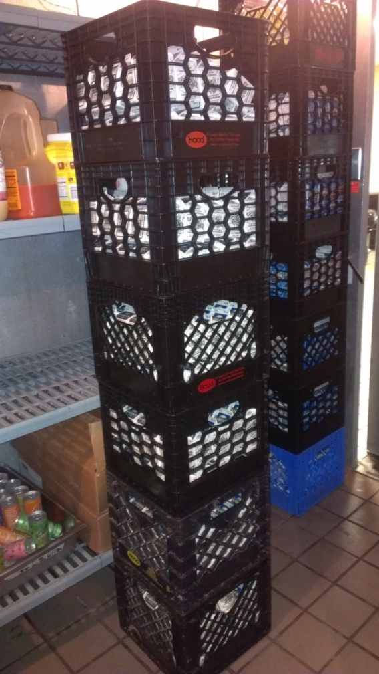
Storage (Walk/Reach-in Cooler)
Rotate milk
Store away from other foods
Check cooler temp twice daily
Wipe up spills immediately and clean regularly
Close door immediately after entering and exiting
Notes:
Rotate milk
Fresh milk in the back on the bottom
Store away from other foods
Milk develops off-flavors from other foods, especially produce
Check cooler temp twice daily
Keep refrigerator temp between 33° F and 41° F, 35° F is ideal
Wipe up spills immediately and clean regularly
Close door immediately after entering and exiting
Can you identify anything that could be improved in this picture?

Slide 25
Storage & Service (Milk Cooler)
Check cooler temp twice daily
Keep refrigerator temp between 33° F and 41° F, 35° F is ideal
Check temp of milks at beginning and end of lunch weekly
Milk temp should be between 33° F and 41° F, 35° F is ideal
Milk cooler thermostat should be set so milk is no warmer than 35° F at beginning of lunch, but not cold enough to freeze
Notes:
Milk coolers with forced cold air keep milk coldest, glass door merchandisers attractively display the milk while maintaining a cold temp as well when the door is closed between service periods.

Slide 26
Storage & Service (Milk Cooler)
Rotate milk
Fresh milk in the back on the bottom
Keep cooler closed until service begins
Close cooler door during breaks in service
If your cooler has curtains, make sure they are clean and in good condition
Do not point fans at milk cooler (fans can pull cold air out of cooler, warming milk)
Notes:
Ideally this should be done with a milk cooler as part of the class to point out the different tips, creating a more stimulating presentation.

Slide 27
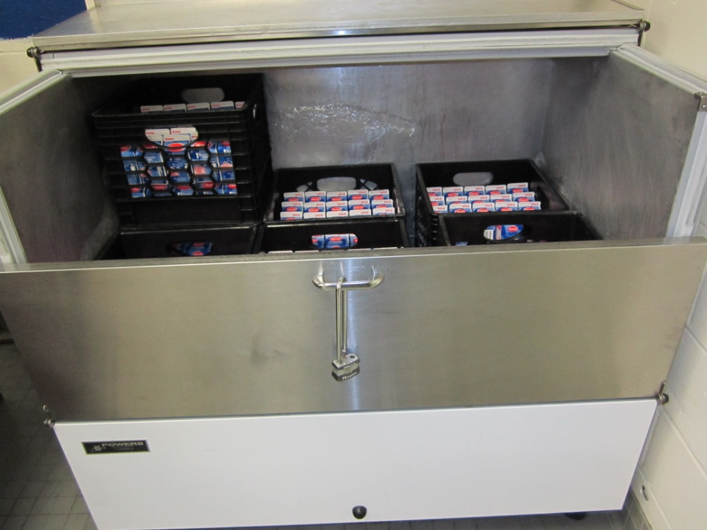
Storage & Service (Milk Cooler)
Keep milks below the load/chill line
Place milk crates at the lowest level possible during service; the higher the crate the higher the milk temp will be
Notes:
Ideally this should be done with a milk cooler as part of the class to point out the different tips, creating a more stimulating presentation.
Do not stack extra milk on top of a full crate above chill line.

Slide 28
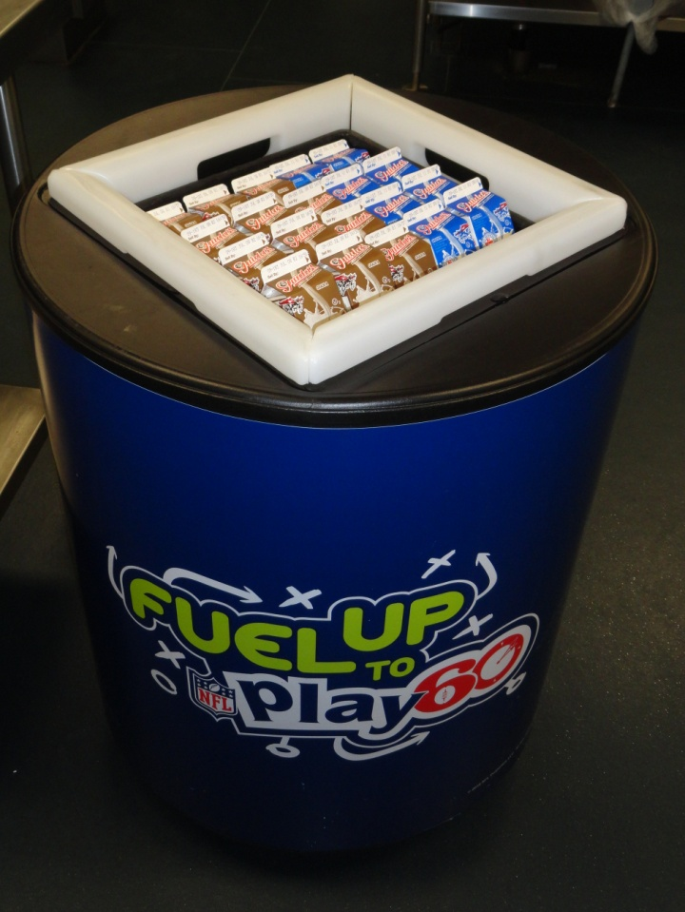
Alternate Site Service Tips
If milk is served at an alternate site, use one of the following to keep milk cold:
Cooler barrel
Smaller cooler on wheels
Insulated cooler bag
Pan of ice

Slide 29
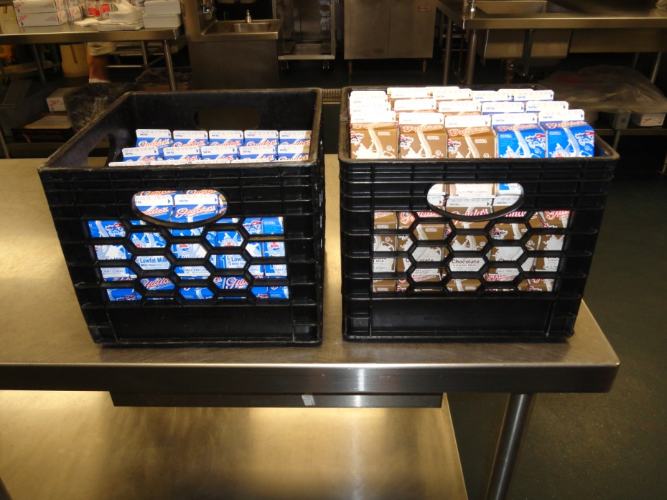
Alternate Site Service Tips
Do not leave milk out in the open without refrigeration
Unopened milks not taken by students should be discarded

Slide 30
Cooler Maintenance
Wipe cooler out daily
Clean with soap and water, then sanitize weekly (do not use bleach or ammonia)
Flush drains regularly with cleaner
Door latches should be in working order and tight
Flush drains regularly with cleaner
Notes:
Have your class stand and investigate an actual milk cooler during the cooler maintenance slides (30 to 33) of this presentation.

Slide 31
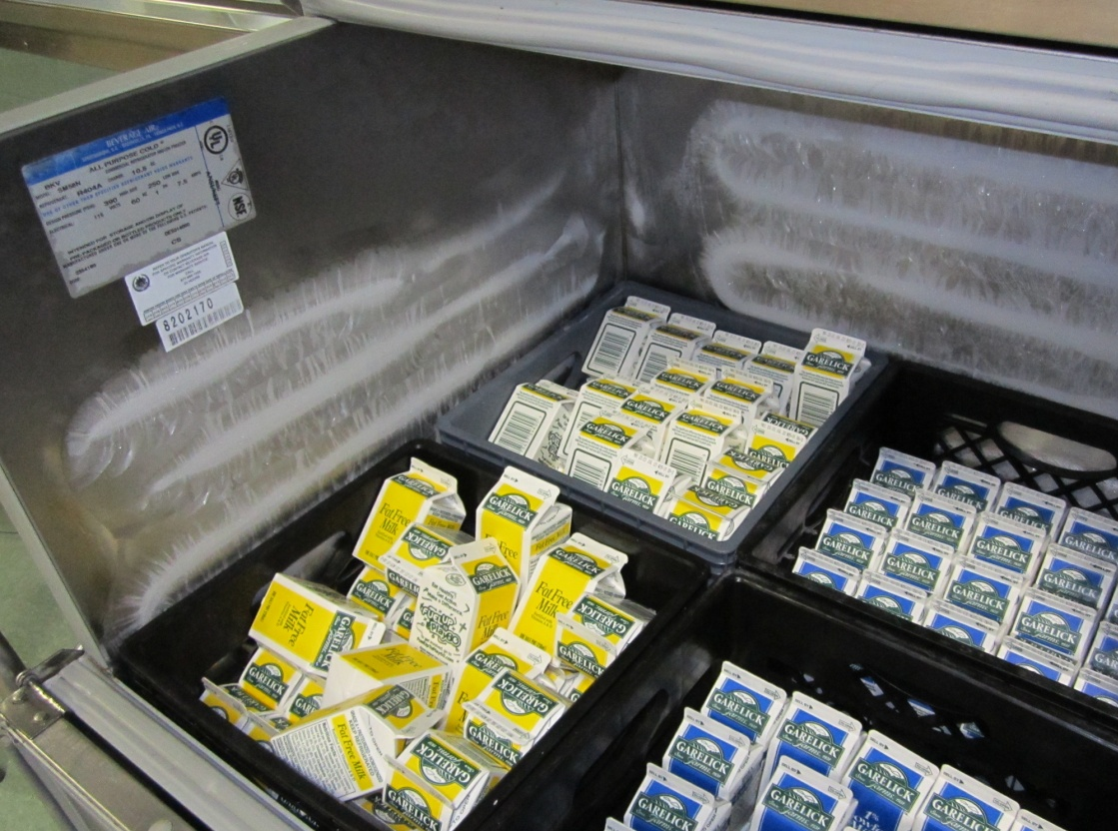
Cooler Maintenance
Do not allow ice to form on cooler walls (ice decreases efficiency of coolers)
Ensure cooler is free of holes and rust spots
Notes:
The thermostat should be set slightly higher or replaced if it is unable to maintain proper temperature without icing.

Slide 32
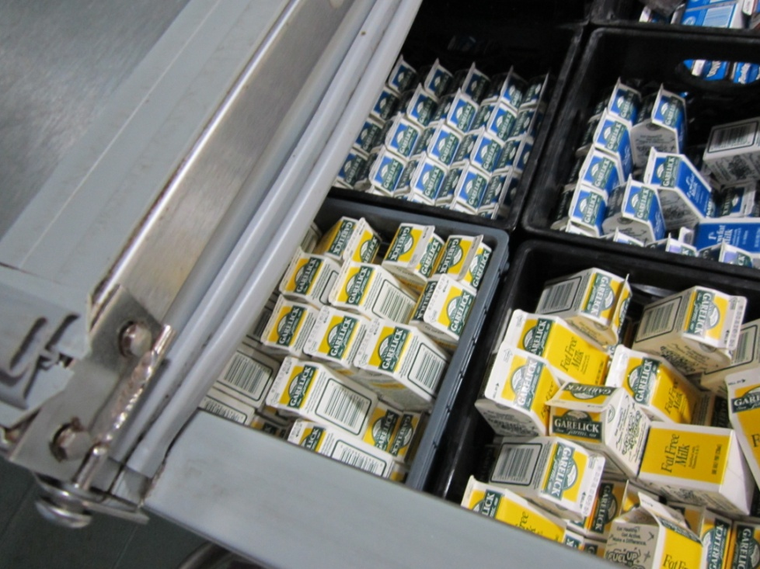
Cooler Maintenance
Gaskets should be smooth and pliable
Brittle, torn, split or ragged gaskets will allow warm air to leak in and cold air to escape
Notes:
Have your class stand and investigate an actual milk cooler during the cooler maintenance slides (30 to 33) of this presentation.

Slide 33
Cooler Maintenance
Air vents and condenser unit should be clean and free of dust and debris
Position cooler so air can flow freely around vent and condenser unit
Electrical cords and plugs should be free of damage
Do not place heavy objects on top of the cooler (can damage gaskets and lid)
Notes:
Have your class stand and investigate an actual milk cooler during the cooler maintenance slides (30 to 33) of this presentation.

Slide 34
Milk Check
Would you want to drink milk that’s been sitting on the counter for half of an hour?
Kids prefer milk cold at 35° F; do your part to make it happen
Milk Temp Check Time!
Notes:
Have employees test temperature and taste of their milk one last time and record on Check List.

Slide 35
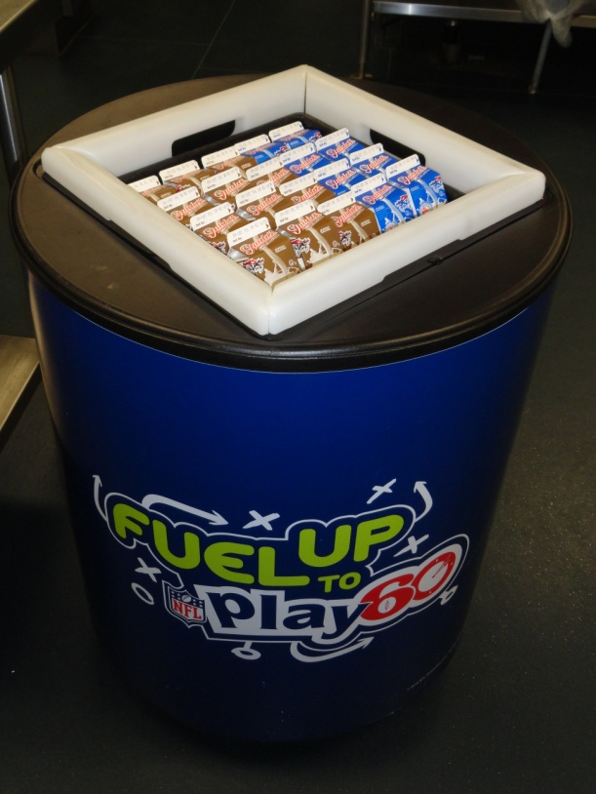
Next Steps
Return to your kitchen and complete the Milk Quality Check List
Take the steps to make sure your students have fresh, ice cold milk every day

